Slide 1

UNIVERSITY INSTITUTE OF ENGINEERING
COMPUTER SCIENCE ENGINEERING
Bachelor of Engineering (Computer Science & Engineering)
Subject Name: Big Data Analytics
Subject Code: 20CST-471
Data lakes
Mapped with CO3
Prepared By:
Er. Ankita Sharma
DISCOVER . LEARN . EMPOWER

Slide 2
Data Lakes: Concept and a Architecture and Use of Amazon S3 and Azure Data Lake
A Data Lake is a centralized repository that allows organizations to store vast amounts of raw and processed data in its native format until needed. It provides a scalable and cost-effective solution for handling diverse types of data, including structured, semi-structured, and unstructured data. Unlike traditional data warehouses, Data Lakes offer a schema-on-read approach, allowing users to structure and interpret the data when it's retrieved rather than imposing a predefined schema during storage. This flexibility makes Data Lakes well-suited for big data analytics, machine learning, and other advanced data processing tasks.

Slide 3
Architecture: The architecture of a Data Lake typically consists of three main layers:
Storage Layer:
Data Lakes leverage scalable and distributed storage systems. In cloud environments, object storage services are commonly used. In the case of Amazon S3 (Simple Storage Service) or Azure Data Lake Storage, these services provide the foundation for storing vast amounts of data with high durability and availability.
Processing Layer:
The processing layer involves tools and frameworks for analyzing and processing the data stored in the lake. Technologies like Apache Spark, Apache Flink, and Hadoop are often used for large-scale data processing and analytics. These tools can operate directly on the data stored in the Data Lake without the need for complex ETL processes.

Slide 4
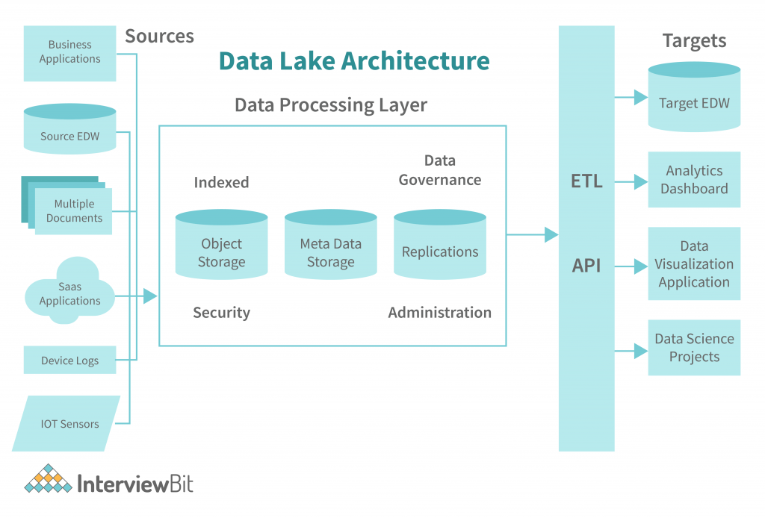

Slide 5
Management Layer:
The management layer includes metadata, governance, and security mechanisms. Metadata management is crucial for cataloging and understanding the data stored in the lake. Governance and security tools help enforce access controls, ensuring that data is appropriately protected and complies with regulatory requirements.
Use of Amazon S3 and Azure Data Lake:
Amazon S3:
Storage and Scalability: Amazon S3 is a highly scalable and durable object storage service. It provides virtually unlimited storage capacity, making it suitable for storing massive amounts of raw and processed data in a Data Lake.

Slide 6
Cost-effectiveness: S3 offers a cost-effective solution with pay-as-you-go pricing, allowing organizations to scale their Data Lake storage needs without the need for upfront investments. Azure Data Lake Storage:
Integration with Azure Services: Azure Data Lake Storage (ADLS) seamlessly integrates with other Azure services, providing a cohesive ecosystem for building and deploying data-driven applications.
Hierarchical Namespace: ADLS includes a hierarchical namespace, which organizes data into directories and subdirectories, allowing for more efficient organization and retrieval of data.

Slide 7
Common Use Cases:
Analytics and Business Intelligence:
Data Lakes support advanced analytics and business intelligence by providing a unified platform to analyze diverse datasets without the constraints of predefined schemas.
Machine Learning and Data Science:
Data Lakes serve as a valuable resource for machine learning and data science applications, providing access to a wide variety of data that can be used to train models and derive insights.
Real-time Data Processing:
With the right architecture and tools, Data Lakes can support real-time data processing, enabling organizations to ingest, process, and analyze streaming data for immediate insights.

